Slide 1
Aviation and the Environment
File created on: 7/10/2025 1:28:55 AM

Slide 2
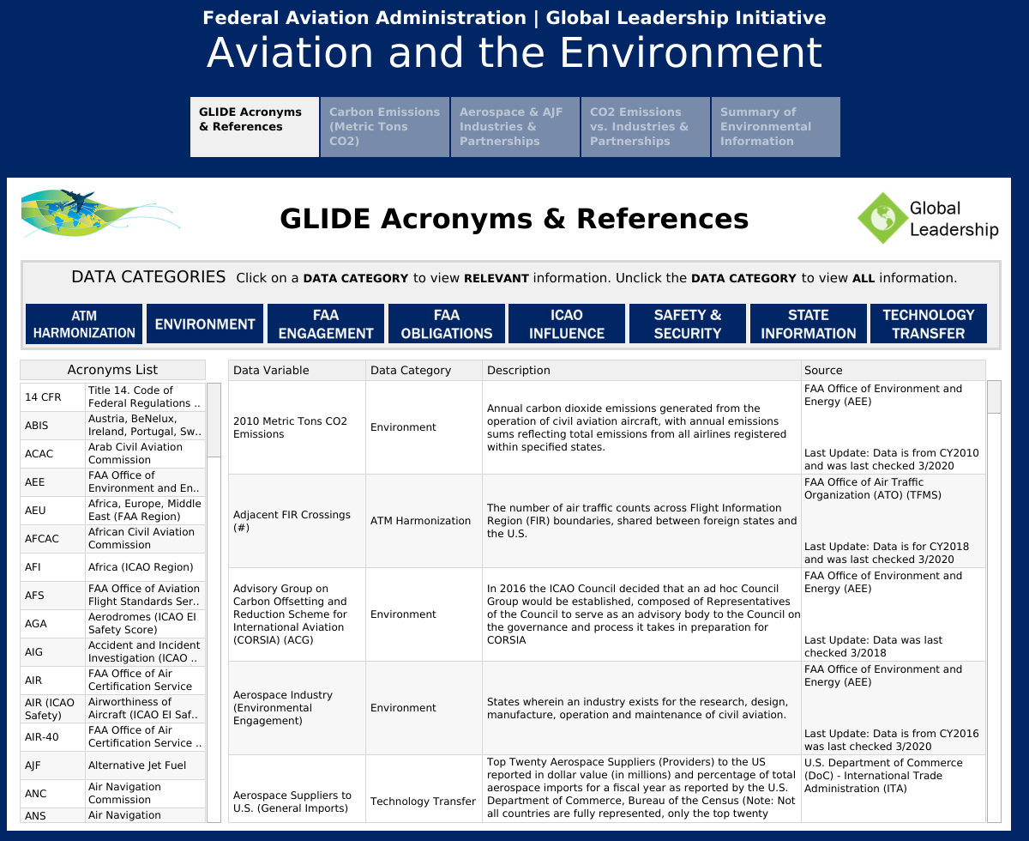

Slide 3
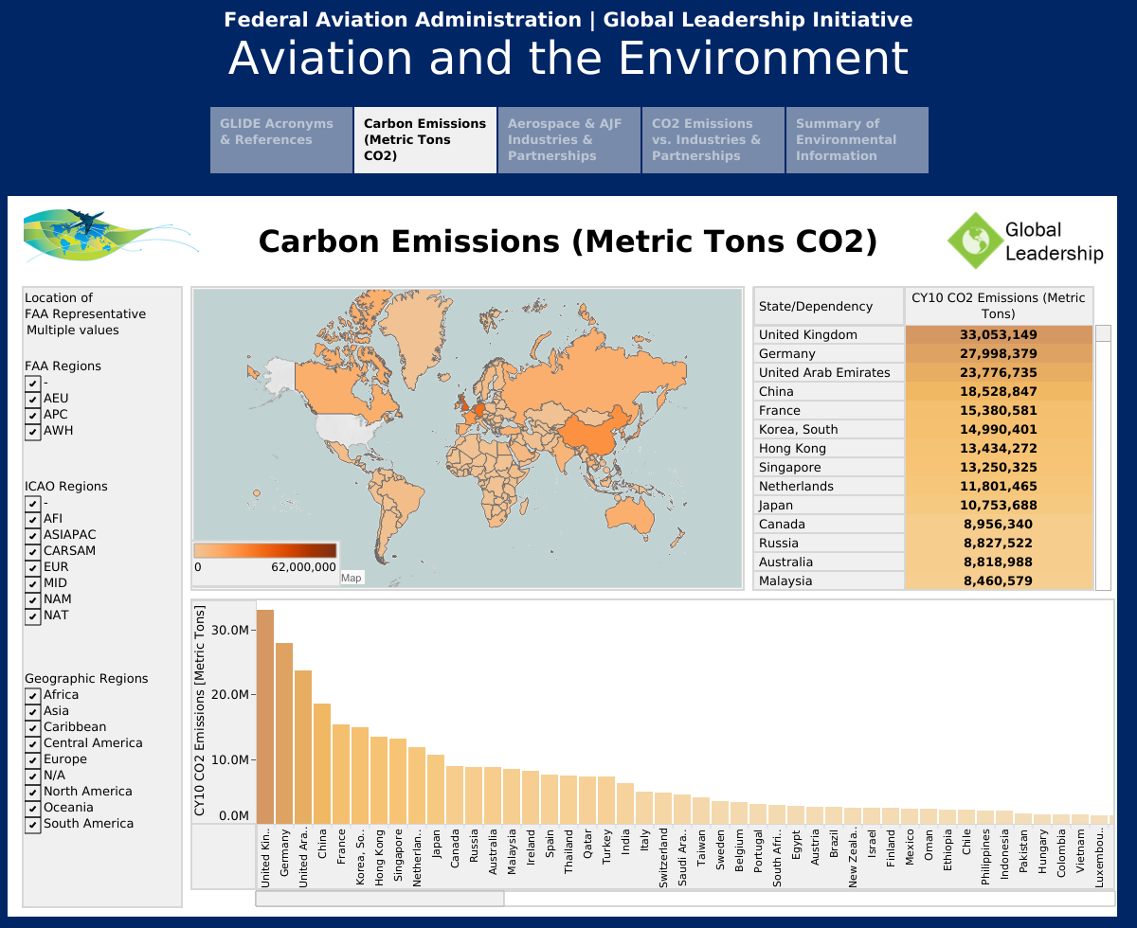

Slide 4
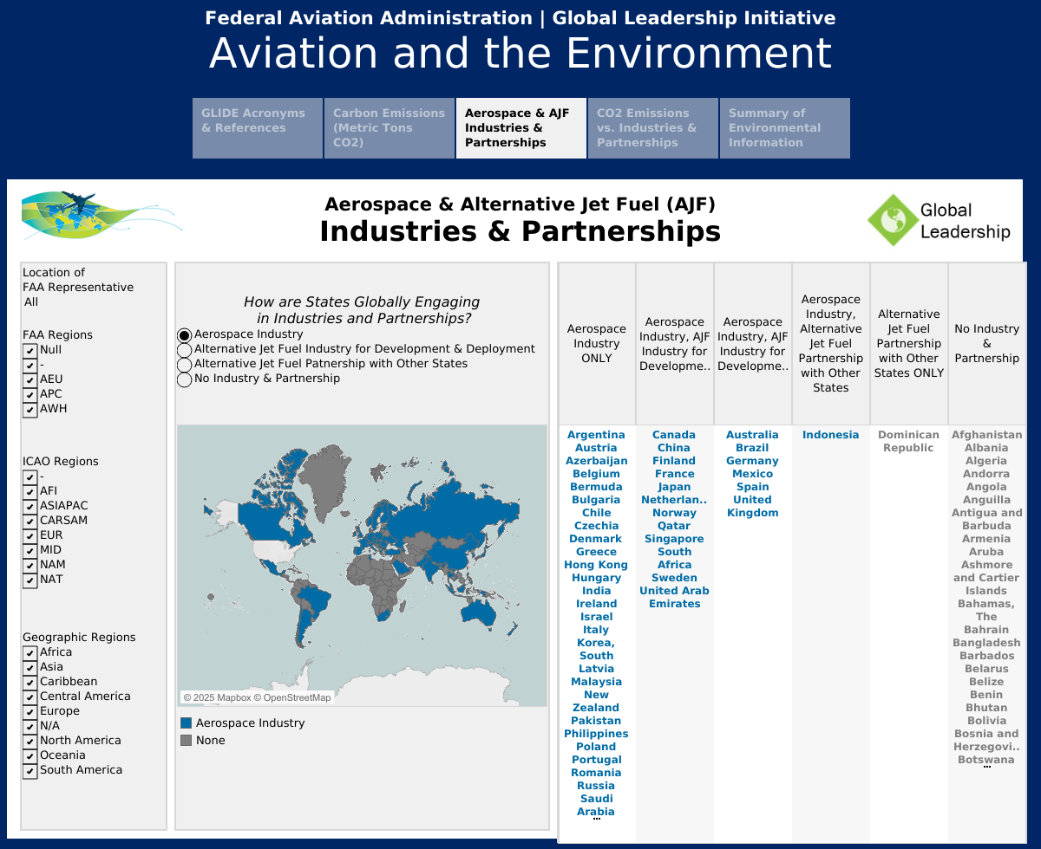

Slide 5
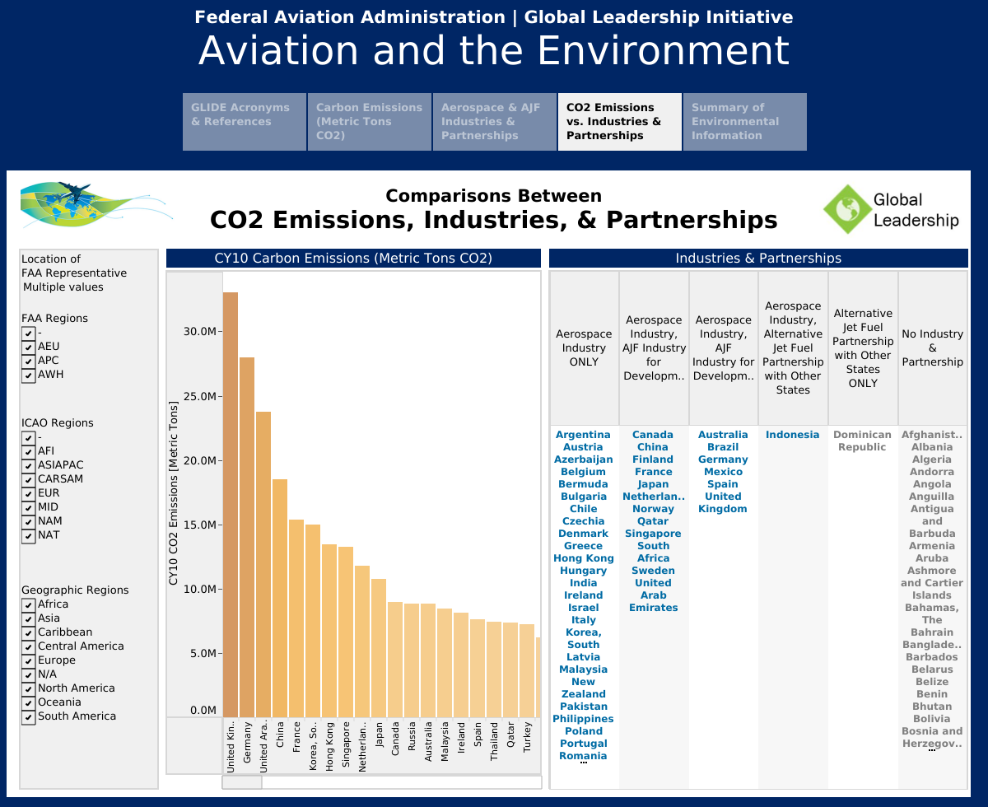

Slide 6
